Slide 1
Anna SZLAVI
Johannes Kepler University (Austria)
Assistant Professor
anna.szlavi@jku.at

Slide 2



My expectations
First and foremost community building

Slide 3
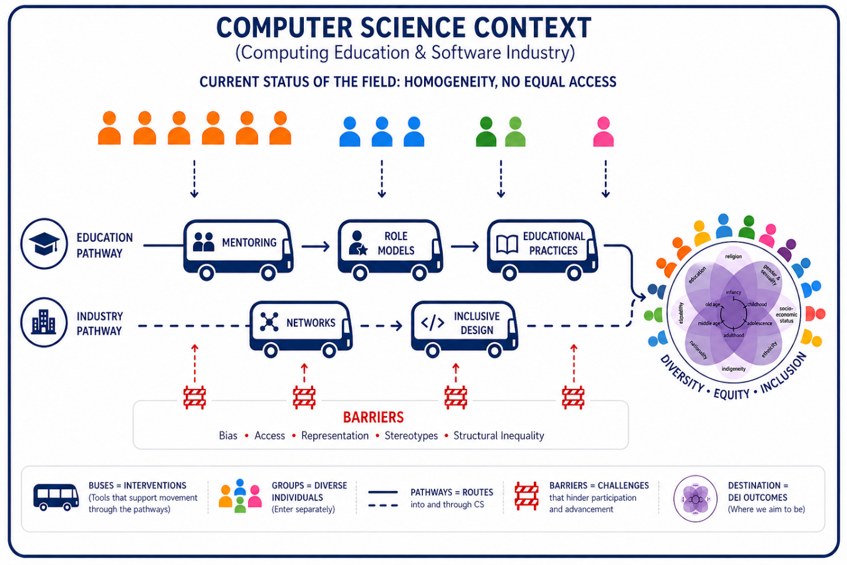
Relevant background

Slide 4
Ideas for actions
joint papers
joint project proposals
“best practices” editions
short awareness raising campaigns

