Slide 1


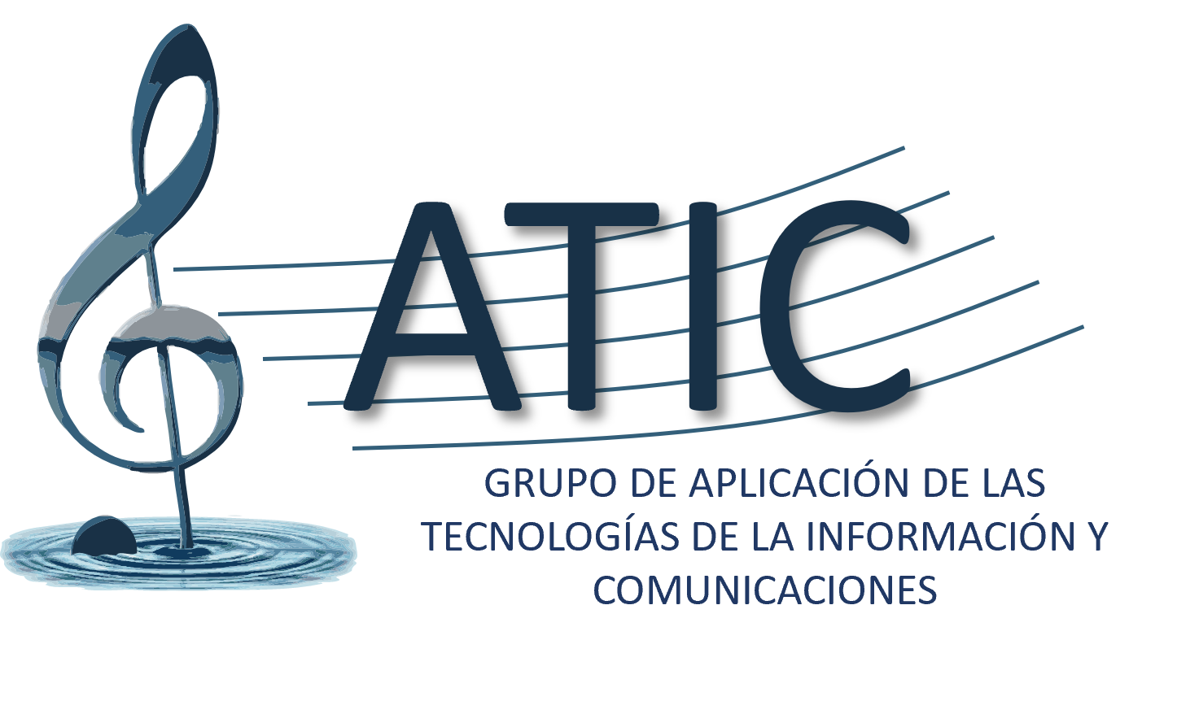
Isabel BARBANCHO
Universidad de Málaga
Full Professor
ibp@uma.es

Slide 2
Your expectations
Foster collaborative research networks
Establish connections with research groups interested in music, EEG-based analysis of art, music, and language, as well as with complementary expertise.
Develop interdisciplinary research lines
Promote joint projects combining neuroscience, music, technology, and cultural sectors, especially in collaboration with museums and music-related institutions.
Prepare European research proposals
Build strong partnerships aimed at applying for competitive European funding programs.
Enhance technology transfer and societal impact
Translate research outcomes into practical applications, including new music paradigms, artistic experiences, cultural innovation, and tools for understanding brain activity through sonification.

Slide 3
Relevant background
Computational Music Analysis, Transcription & Sonification
Developing signal processing and AI methods for music analysis and automatic transcription, alongside sonification techniques to better understand brain activity and enrich artistic interpretation.
EEG and Music
Studying neural responses to music perception and engagement, as well as generating music automatically based on computational models and brain data.
EEG and Art Perception
Investigating how visual art influences brain activity using EEG, including emotional and cognitive responses, and enhancing artistic experiences through neural-informed sonification.
EEG and Language & Sign Language Processing
Exploring brain dynamics underlying language comprehension and production, including emerging research on sign language processing using EEG.

Slide 4
Ideas for actions
Co-design inclusive research and cultural experiences
Develop collaborative projects that integrate EEG, music, art, and language to create more inclusive and accessible cultural experiences, particularly in environments such as museums and performance spaces.
Promote neurotechnology for cultural accessibility
Explore how EEG analysis, sonification, and automatic music generation can be used to “translate” and enhance artistic experiences, making them more accessible for people with diverse functional abilities.
Develop interdisciplinary pilot studies
Initiate experimental setups combining brain data, artistic stimuli, and technology to investigate how sensory experiences can be augmented, shared, and better understood.
Contribute to knowledge exchange and dissemination
Share methodologies, tools, and best practices across disciplines to bridge neuroscience, technology, and the cultural sector.

Slide 5
Our involvement
Our research group aim to actively contribute by:
Bringing expertise in EEG signal analysis, music analysis, automatic composition, and sonification.
Co-developing inclusive artistic and musical experiences based on brain activity.
Collaborating with partners to design innovative applications for museums and cultural environments, enabling new ways to experience and feel art and music.
Supporting the development of joint proposals and interdisciplinary research lines.
Our goal is to contribute to creating expanded and shared sensory experiences, where art, music, and language can be perceived in new ways—benefiting both people with diverse functional abilities and the broader public.

